Slide 1
Azure Monitoring and Management

Slide 2
Design for Operations (10-15%)
Design an application monitoring and alerting strategy
Determine the appropriate Microsoft products and services for monitoring applications on Azure; define solutions for analyzing logs and enabling alerts using Azure Log Analytics; define solutions for analyzing performance metrics and enabling alerts using Azure Monitor; define a solution for monitoring applications and enabling alerts using Application Insights
Design a platform monitoring and alerting strategy
Determine the appropriate Microsoft products and services for monitoring Azure platform solutions; define a monitoring solution using Azure Health, Azure Advisor, and Activity Log; define a monitoring solution for Azure Networks using Log Analytics and Network Watcher service; monitor security with Azure Security Center
Design an operations automation strategy
Determine when to use Azure Automation, Chef, Puppet, PowerShell, Desired State Configuration (DSC), Event Grid, and Azure Logic Apps; define a strategy for auto-scaling; define a strategy for enabling periodic processes and tasks
Notes:
https://www.microsoft.com/en-us/learning/exam-70-535.aspx

Slide 3
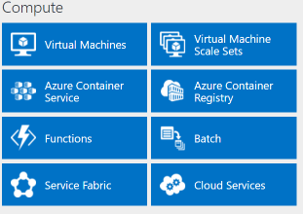
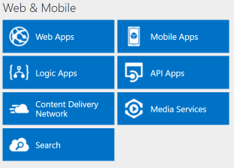
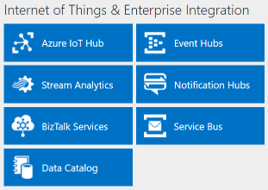
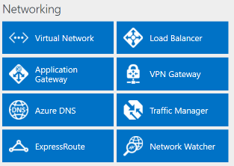
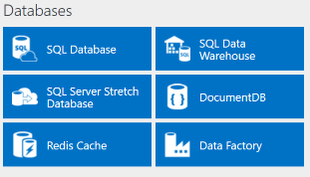
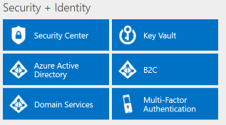
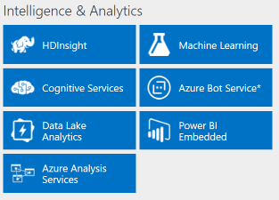
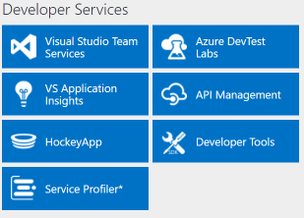
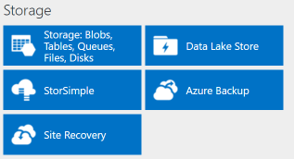
http://azureplatform.azurewebsites.net/
* Preview Services
Notes:
Preview Version 1.7 (2017-04-20)

Slide 4
Azure Monitoring and Management
Azure Monitor
Azure Advisor
Azure Service Health
Azure Network Watcher
Azure Log Analytics
Service Map
Traffic Analytics
Network Performance Monitor
Other Solutions ….
Azure Security Center
Azure Application Insights
Azure Automation
Event Grid
Azure Backup
Azure Site Recovery
Azure Cost Management (ACM)

Slide 5
Azure Monitor

Slide 6
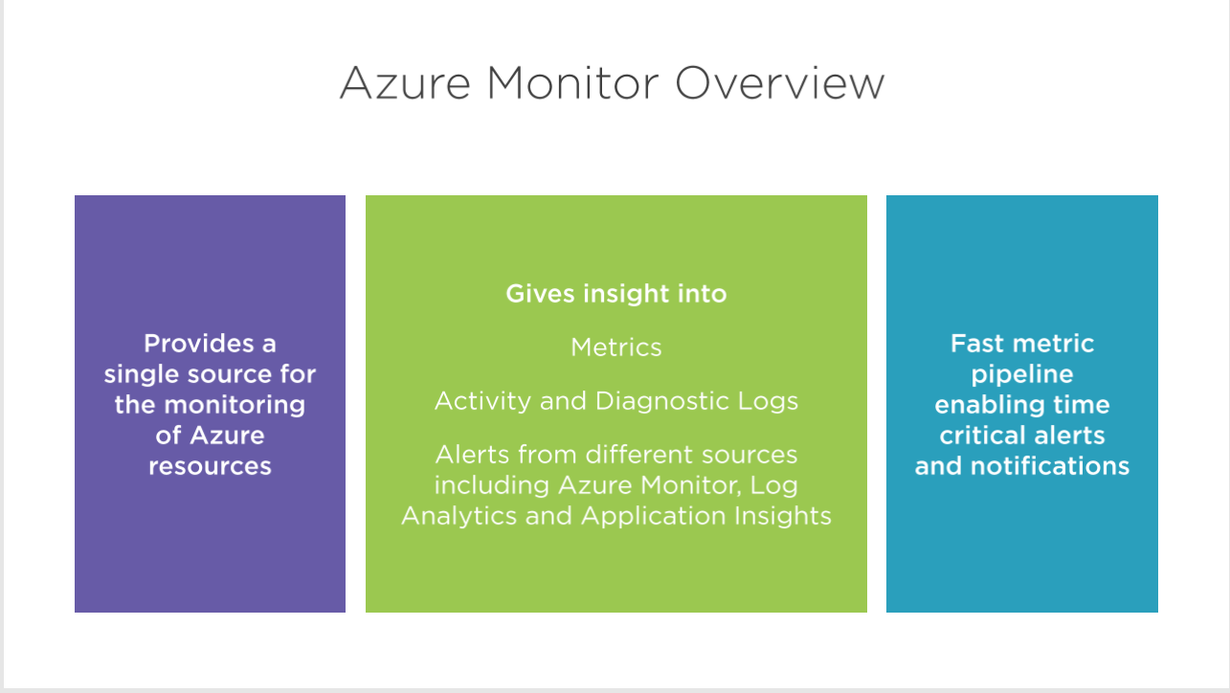

Slide 7
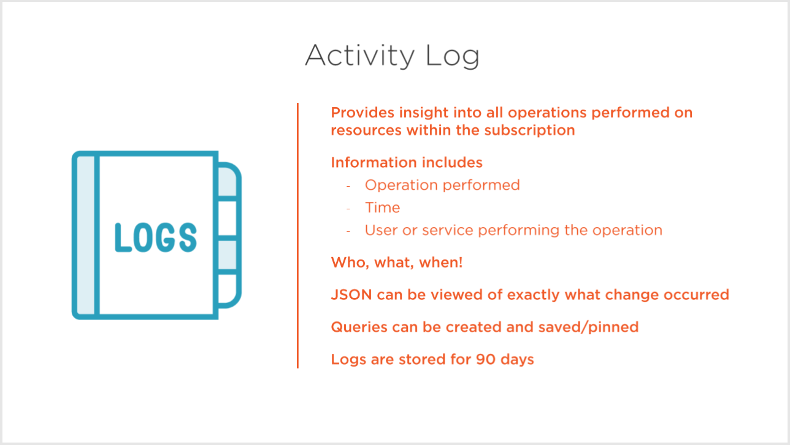

Slide 8
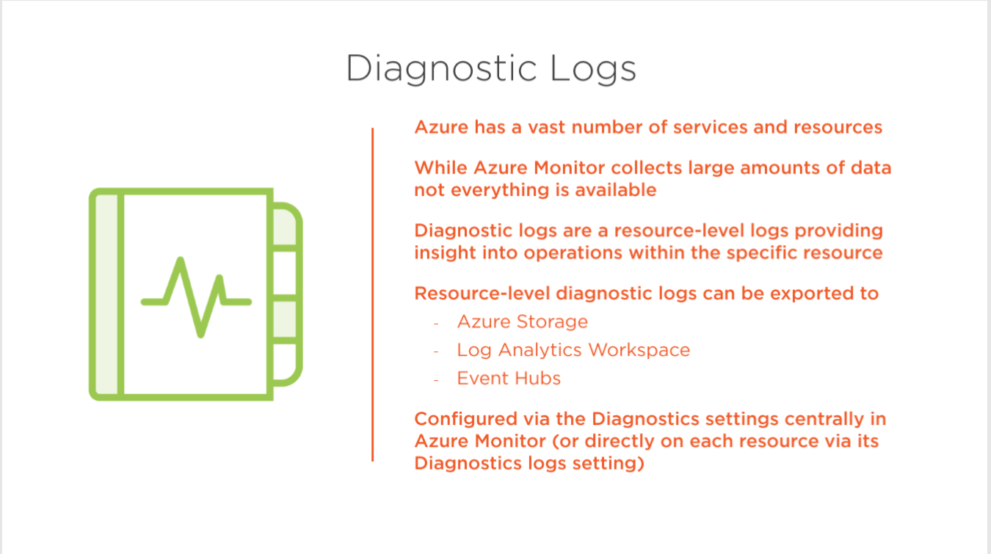

Slide 9
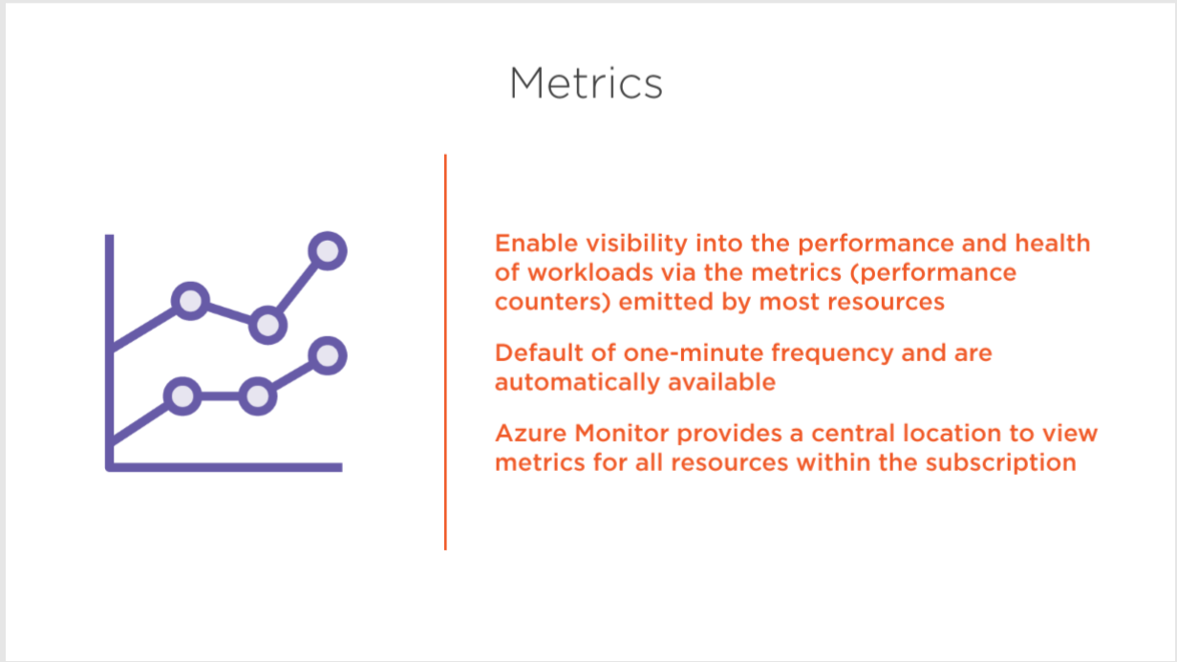

Slide 10
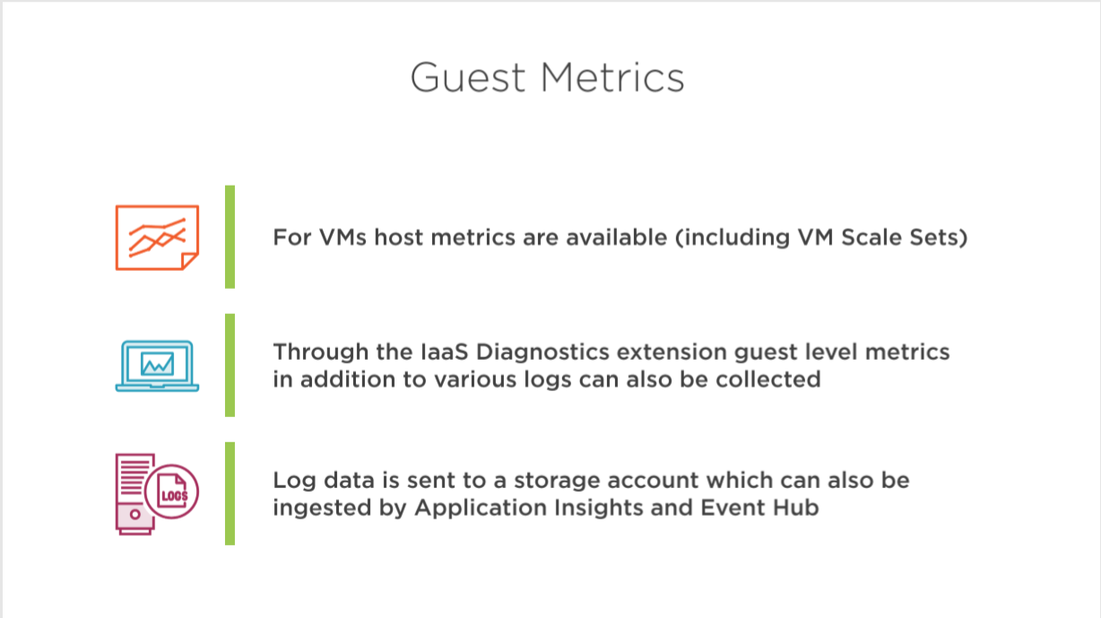

Slide 11
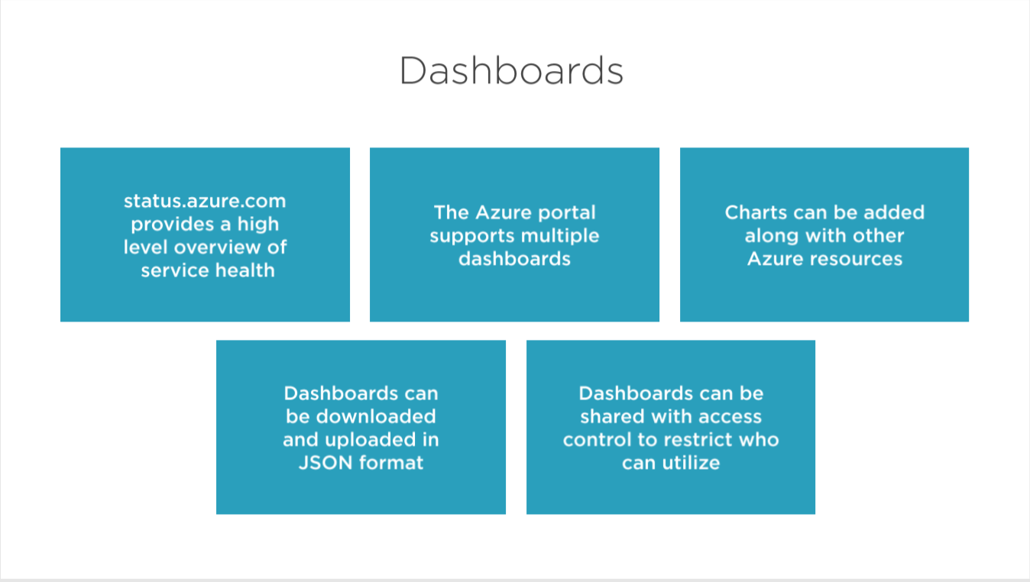

Slide 12
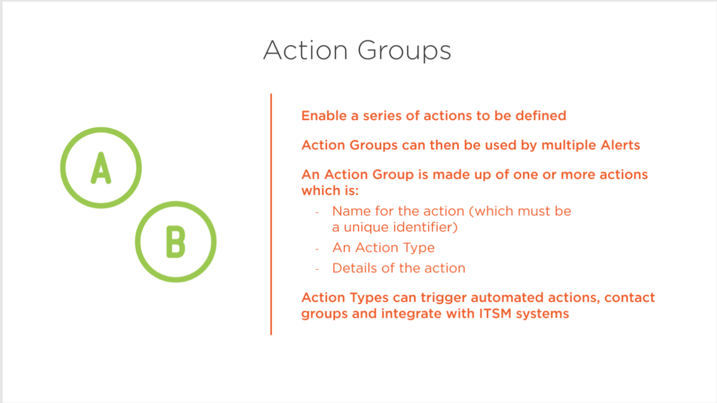

Slide 13
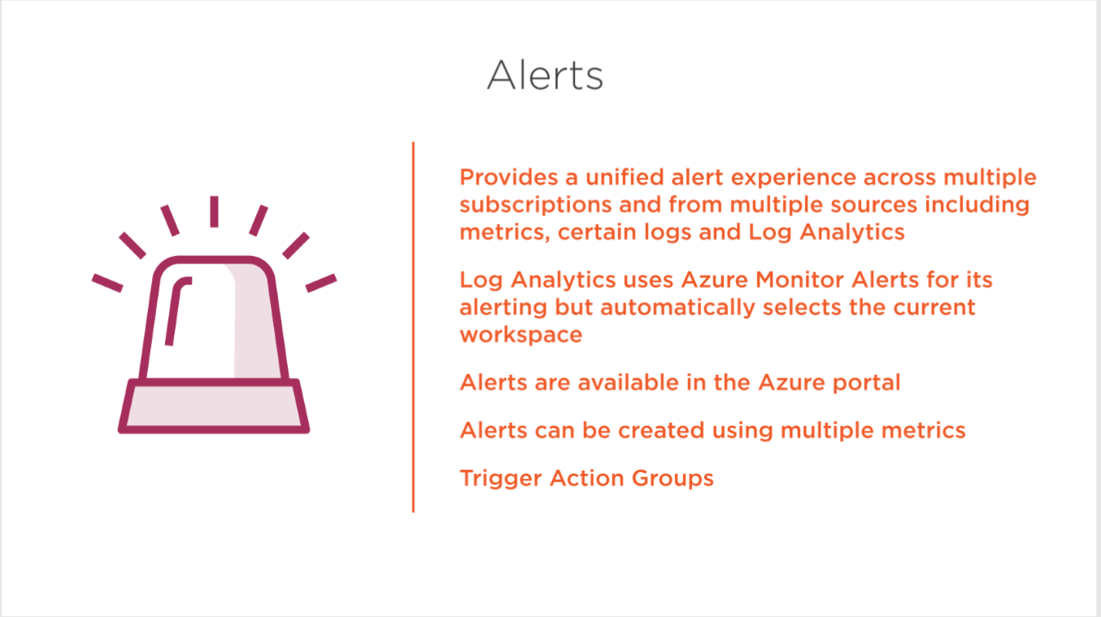

Slide 14
Azure Advisor

Slide 15
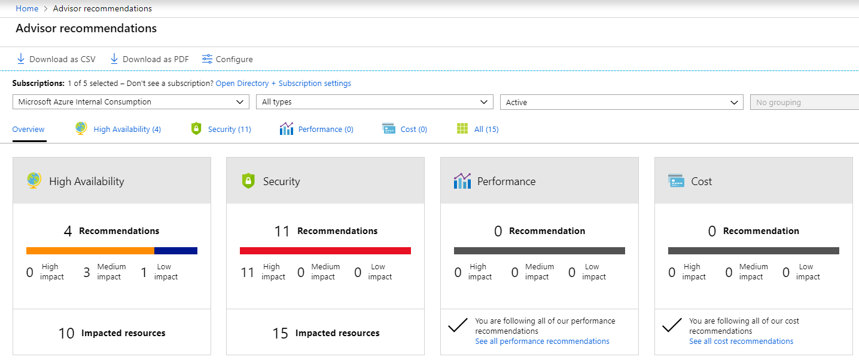

Slide 16
Azure Service Health

Slide 17
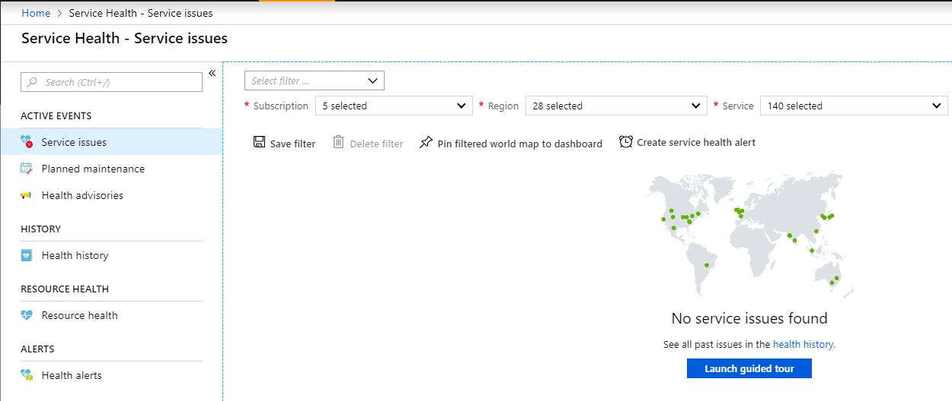

Slide 18
Azure Security Center

Slide 19
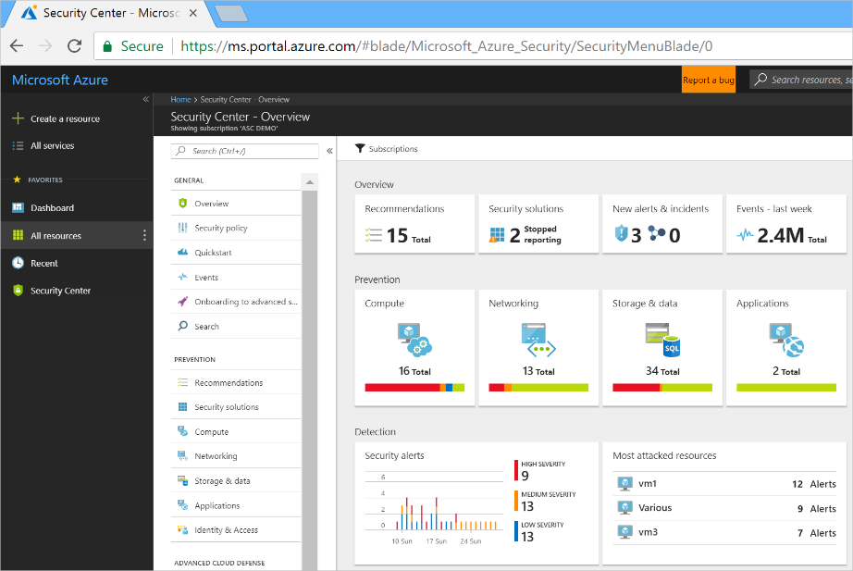
https://docs.microsoft.com/en-us/azure/security-center/security-center-intro
Notes:
https://docs.microsoft.com/en-us/azure/security-center/security-center-intro
Centralized policy management – Ensure compliance with company or regulatory security requirements by centrally managing security policies across all your hybrid cloud workloads.
Continuous security assessment – Monitor the security of machines, networks, storage and data services, and applications to discover potential security issues.
Actionable recommendations – Remediate security vulnerabilities before they can be exploited by attackers with prioritized and actionable security recommendations.
Advanced cloud defenses – Reduce threats with just in time access to management ports and whitelisting to control applications running on your VMs.
Prioritized alerts and incidents - Focus on the most critical threats first with prioritized security alerts and incidents.
Integrated security solutions - Collect, search, and analyze security data from a variety of sources, including connected partner solutions.

Slide 20
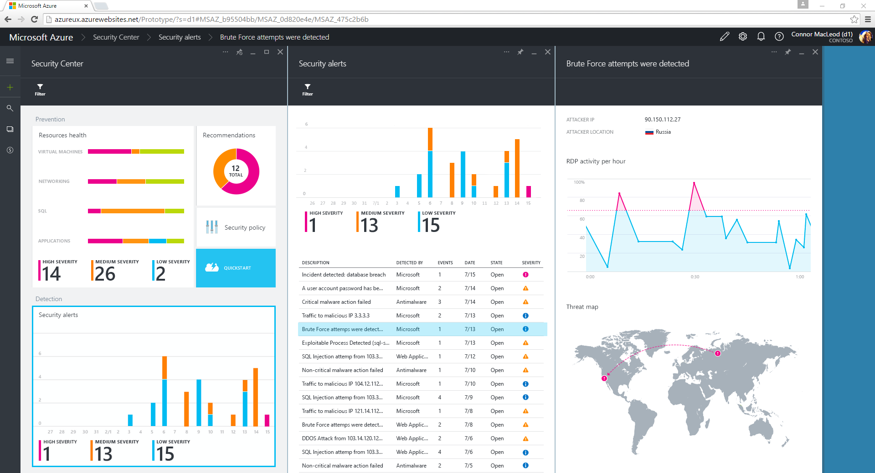
Azure Security Center
Monitor the security state of resources
Prioritized recommendations
Easily deploy partner security solutions
Security policies for subscriptions and resource groups
Central view of your security posture
Prioritized security alerts
Notes:
Speaker: Alejandra
One-stop service for monitoring and managing the security posture of your environments.

Slide 21
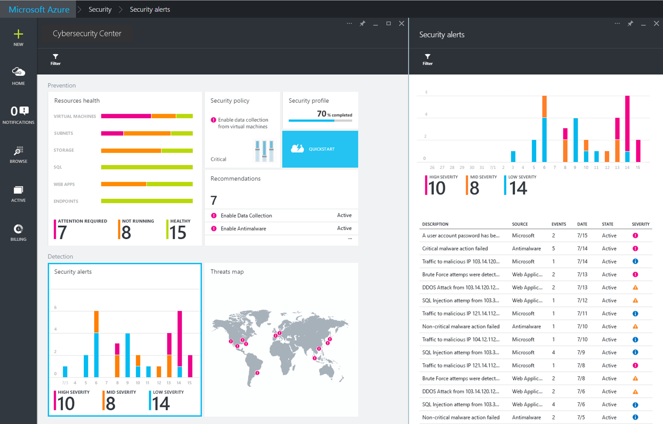
Azure Security Center
Advanced Prevention
Application whitelisting
Just-in-time network access to VMs
Advanced Threat Detection
Brute force detections
Outboard DDoS Botnet Detection
New behavioral analytics servers and VMs to identify suspicious activity
Azure SQL database threat detection
https://azure.microsoft.com/en-us/blog/preview-the-new-enhancements-to-azure-security-center/
Notes:
Speaker: Alejandra
Azure Security Center helps you prevent, detect and respond to security threats with increased visibility and control over the security of your deployments across Azure. Azure Security Center provides visibility into the security state of your Azure resources. It also enables you to set security policies for resources to help you maintain and improve the level of security by deploying, configuring, and managing security controls from Microsoft and its partners.
Azure Security Center helps detect advanced threats with analytics-driven detection. Its machine learning combines information from the global threat landscape that Microsoft observes with activity happening in your Azure deployments to help you see real threats – and fewer false alarms. Azure Security Center helps you build a comprehensive view of your total security posture by exporting security logs to your existing SIEM solution.
Azure Security Center delivers prioritized security alerts, so you can receive and track the most important information. Forensics data helps you investigate incidents, and recommendations help guide your response and recovery.
Key talking points:
Advanced Cloud defenses:
App Whitelisting: Azure Security Center can now automatically discover, recommend whitelisting policy for a group of machines and apply these settings to your Windows VMs using the built-in AppLocker feature.
Just-In-Time Network Access: Attackers commonly target open network ports (RDP, SSH, etc.) with Brute Force attacks. By only opening these ports for a limited time when needed to connect remotely to the VM, Azure Security Center can significantly reduce the attack surface.
Advanced threat detection: All of this capabilities leverage Azure ML
Brute Force Detection: Using Historical patterns to detect brute force attacks against: SSH, RDP, SQL Ports. Many more coming: from FTP, SQUID Proxy to MongoDB and VNC.
Outbound DDoS: New detection algorithms detect when VMs are being used as a part of a cluster to perform DDoS attacks.
Behavioral Analytics: Helps identify suspicious activity, such as process persistency in the registry, processes masquerading as system processes, and attempts to evade application whitelisting.
Azure SQL Database Threat Detection: Identifies anomalous database activities indicating unusual and potentially harmful attempts to access or exploit databases

Slide 22
Azure Network Watcher

Slide 23
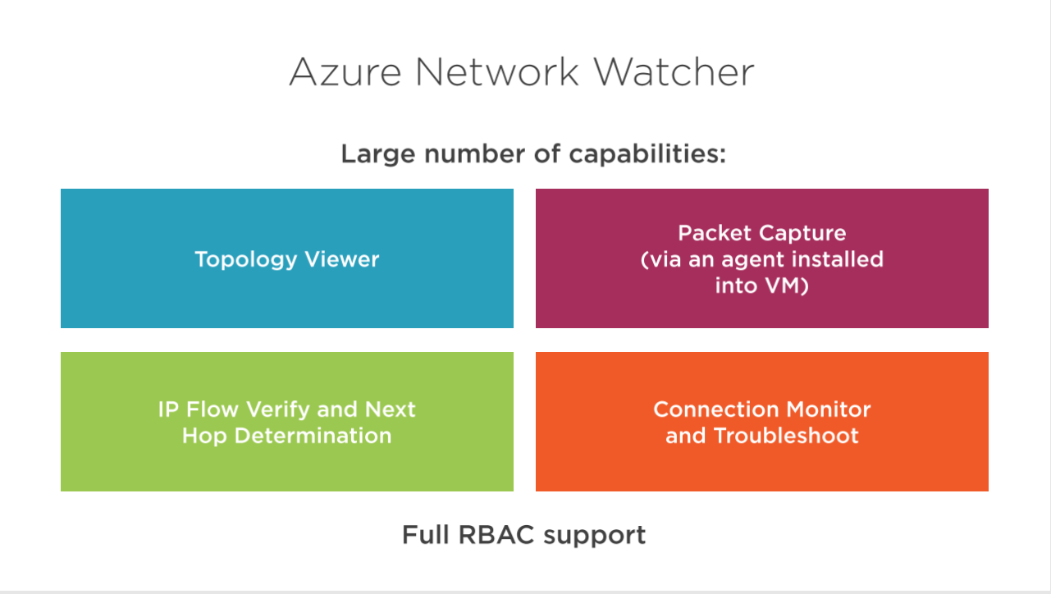

Slide 24
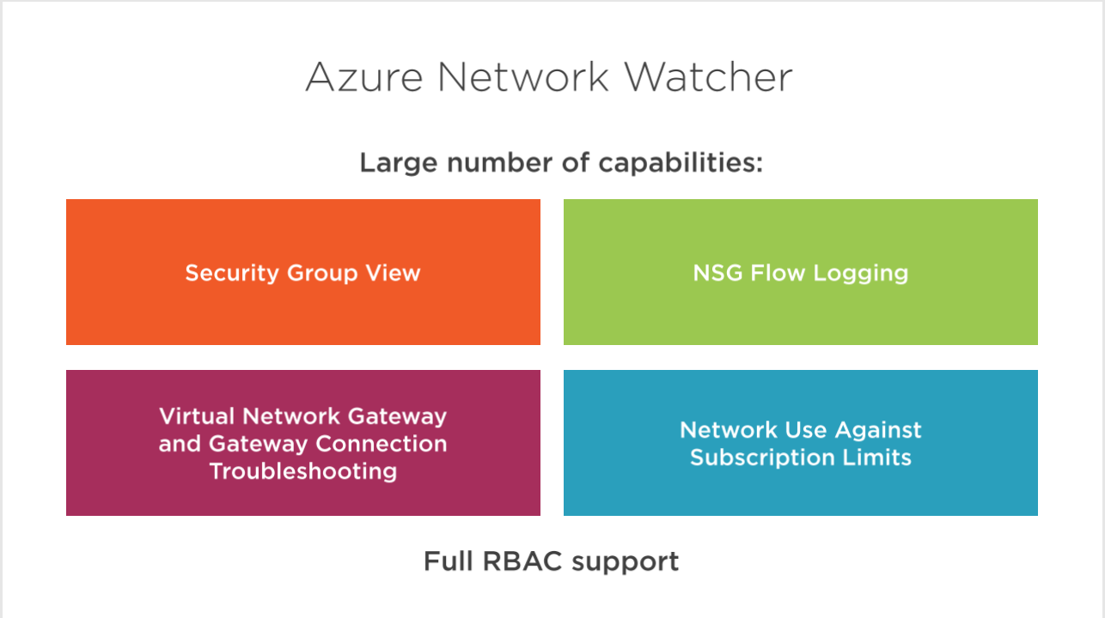

Slide 25
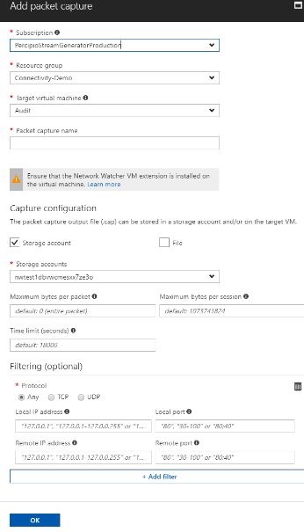
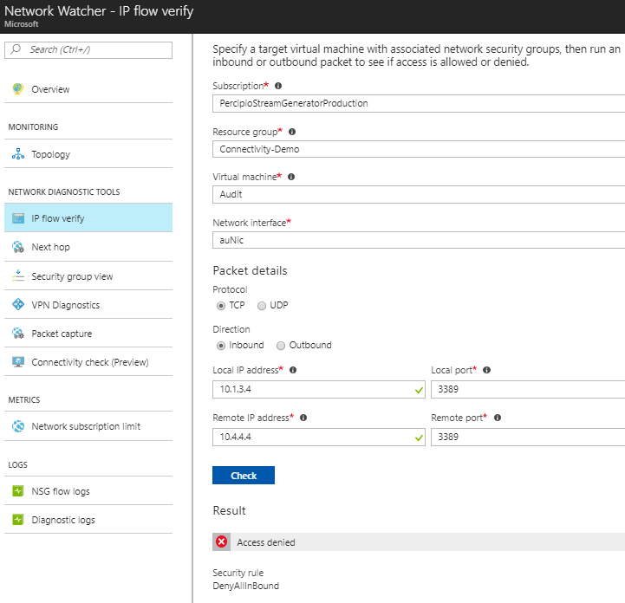
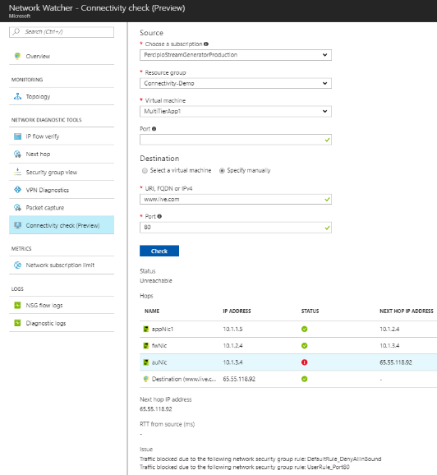
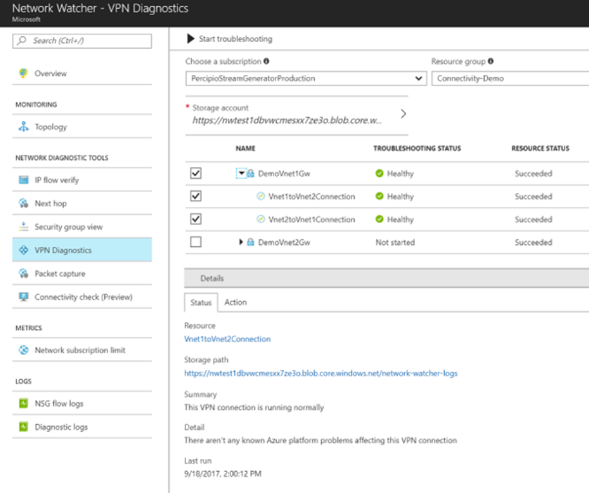
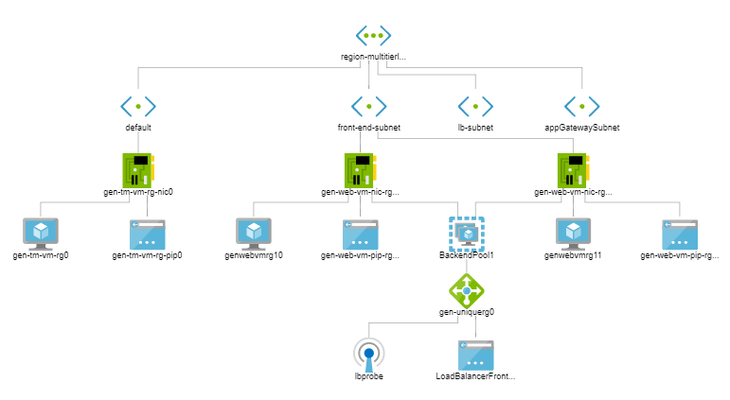
Network Watcher
New
Topology
Visualize your network
Packet Capture
Initiate packet capture from portal or programmatically
Captures stored in .cap format
IP Flow Verify
Identify configured NSG rules blocking traffic
VPN Diagnostics
Troubleshoot VPN Gateway and Connections and identify issues like
Preshared Key mismatch
Unsupported IKE policies
Gateway Unreachable
Gateway instance under maintenance
Connectivity
Diagnose connectivity and latency issues between VM and an Endpoint (VM, FQDN, URI, IPv4 Address)
Identify configuration issues impacting connectivity

Slide 26
Azure Log Analytics

Slide 27
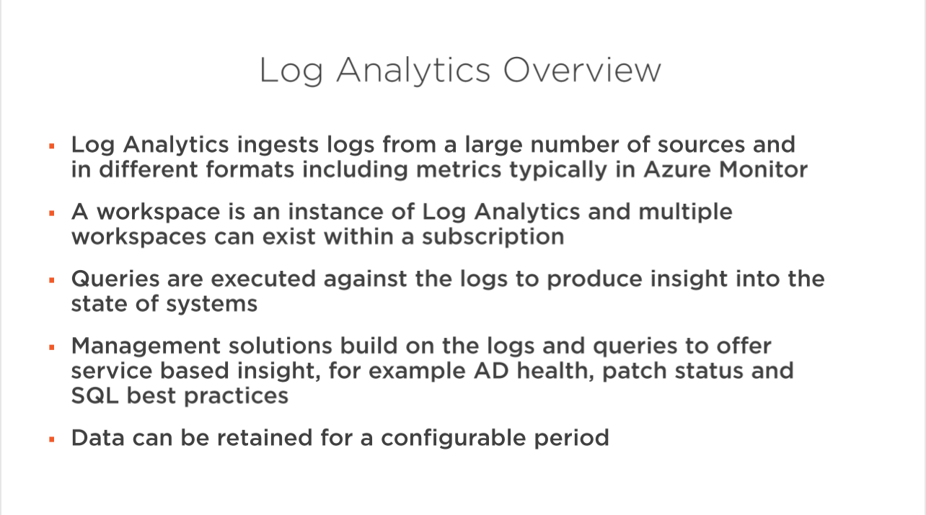

Slide 28
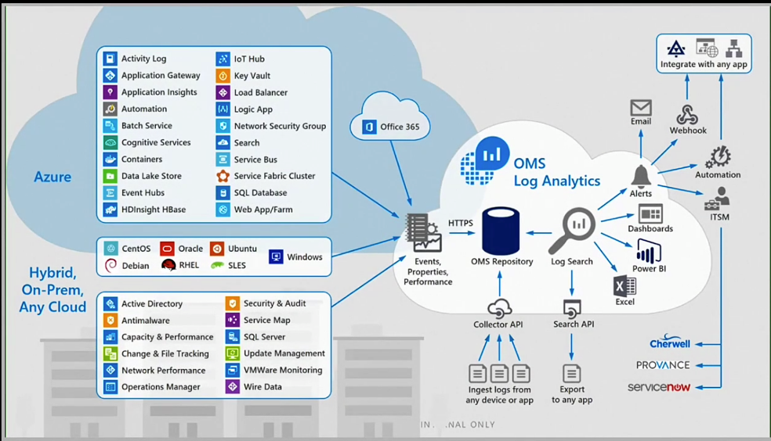
Log Analytics
Notes:
The core functionality of OMS is provided by a set of services that run in Azure.
Each service provides a specific management function, and you can combine services to achieve different management scenarios
https://docs.microsoft.com/en-us/azure/operations-management-suite/operations-management-suite-overview

Slide 29
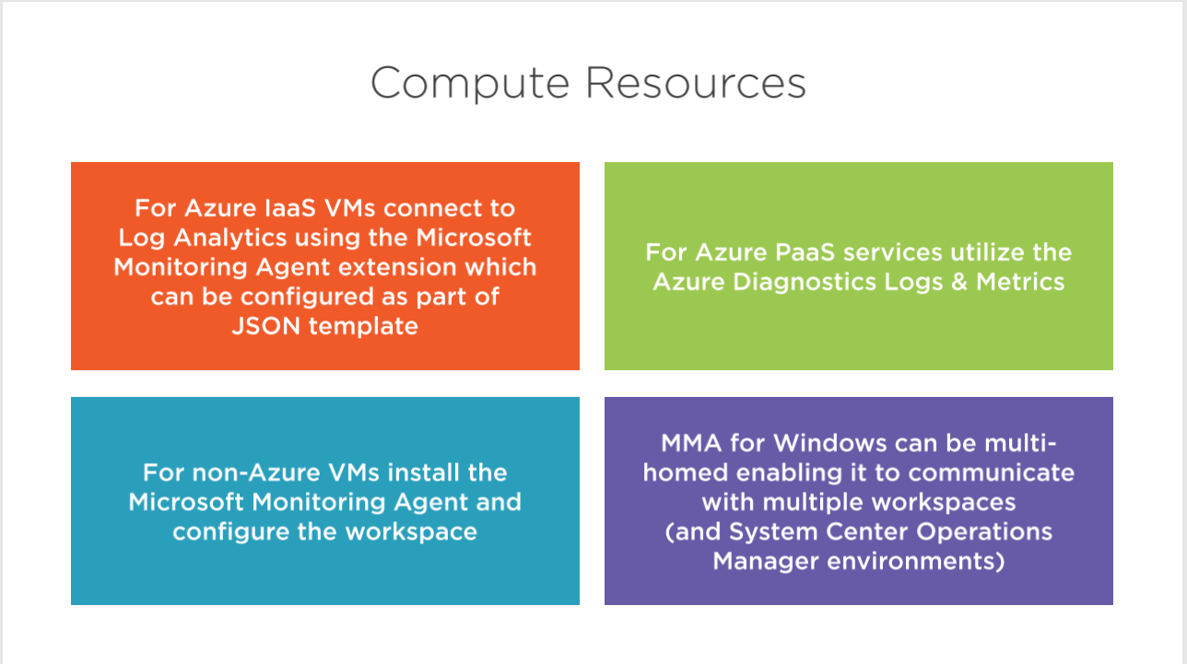

Slide 30
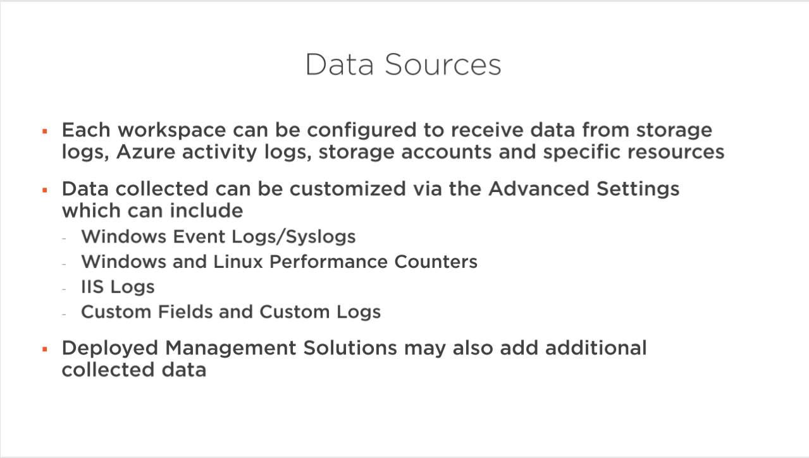

Slide 31
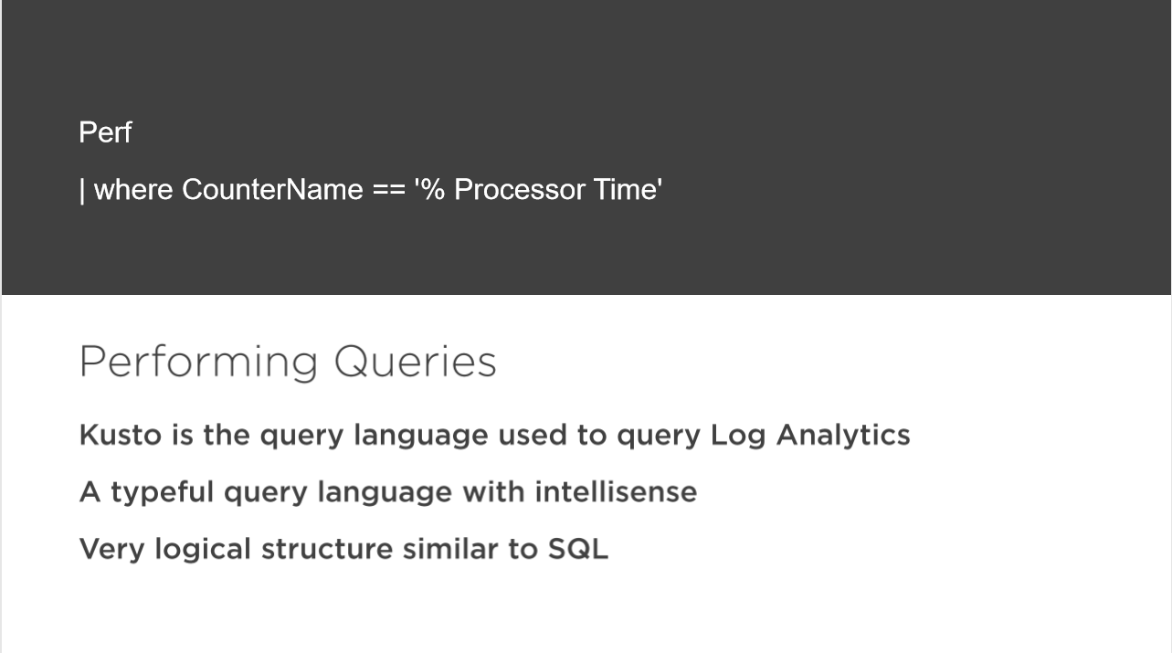

Slide 32
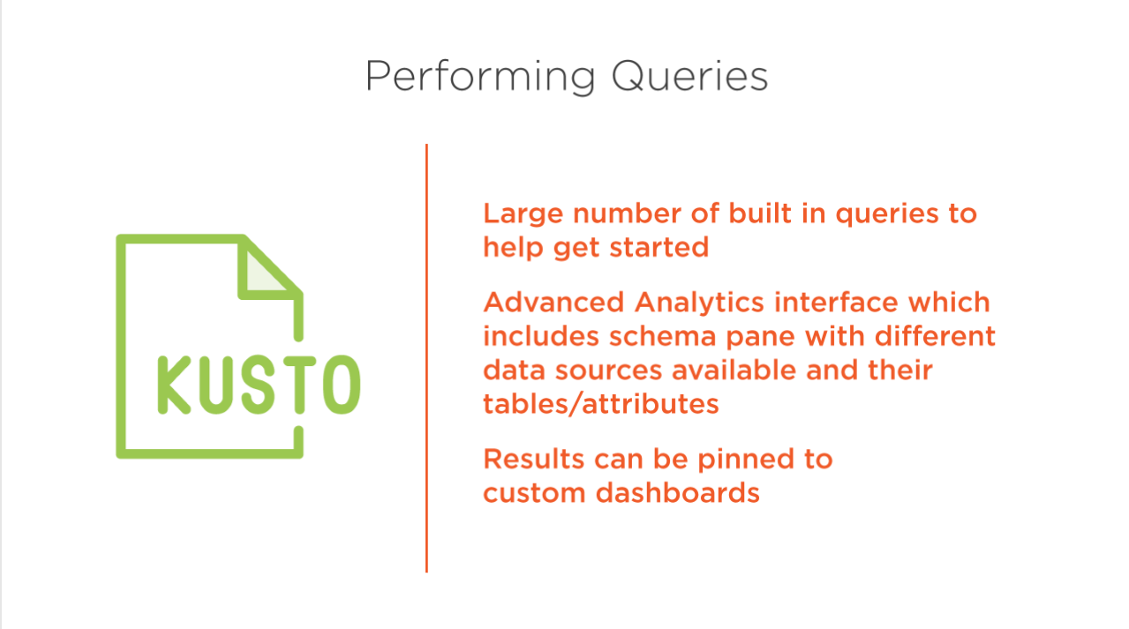

Slide 33
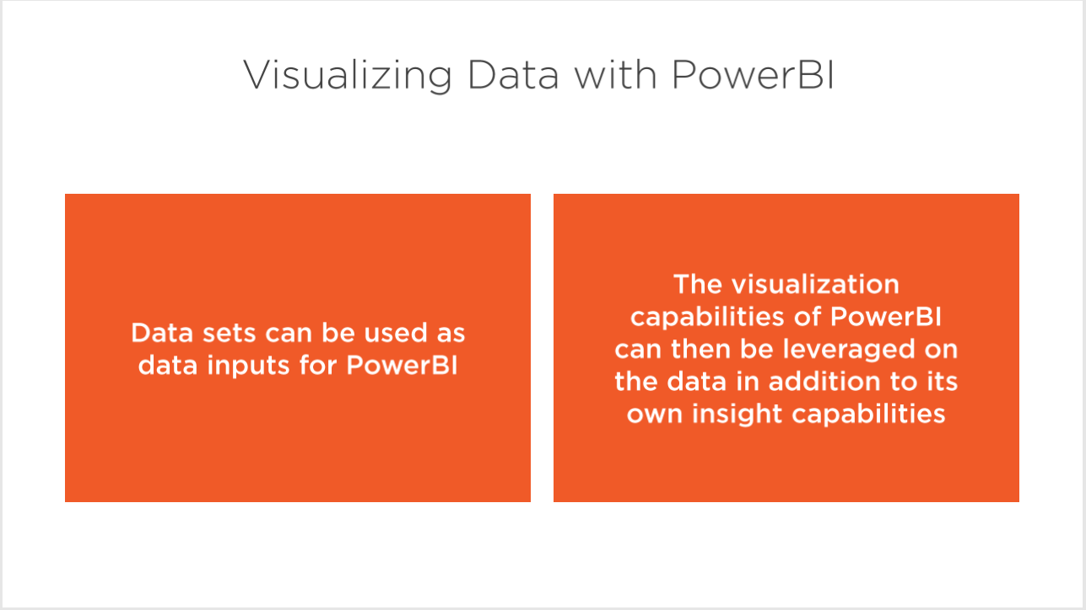

Slide 34
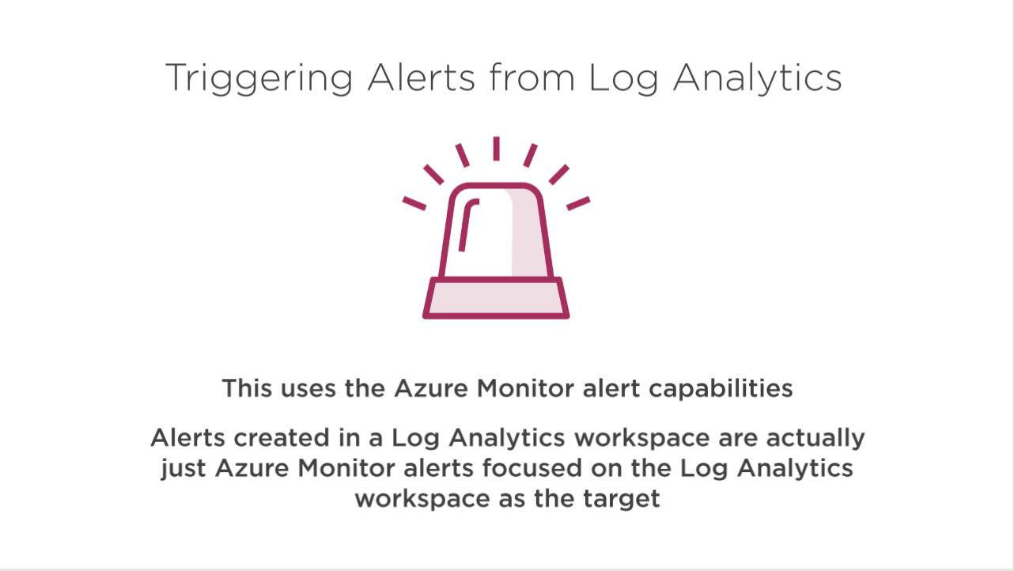

Slide 35
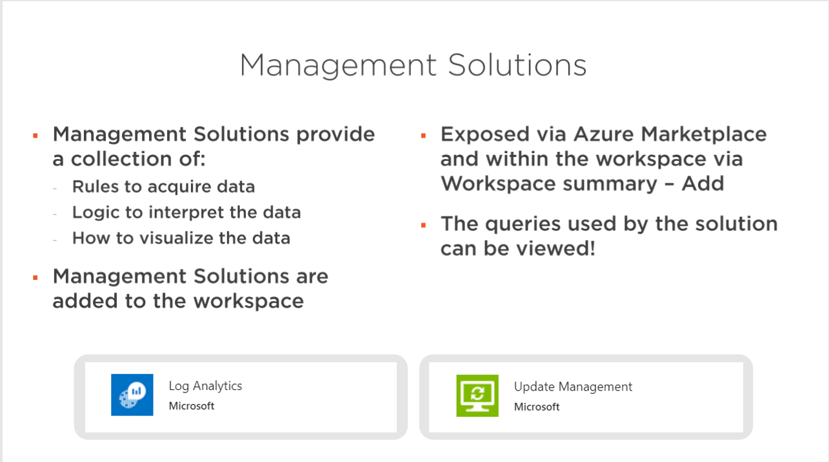

Slide 36
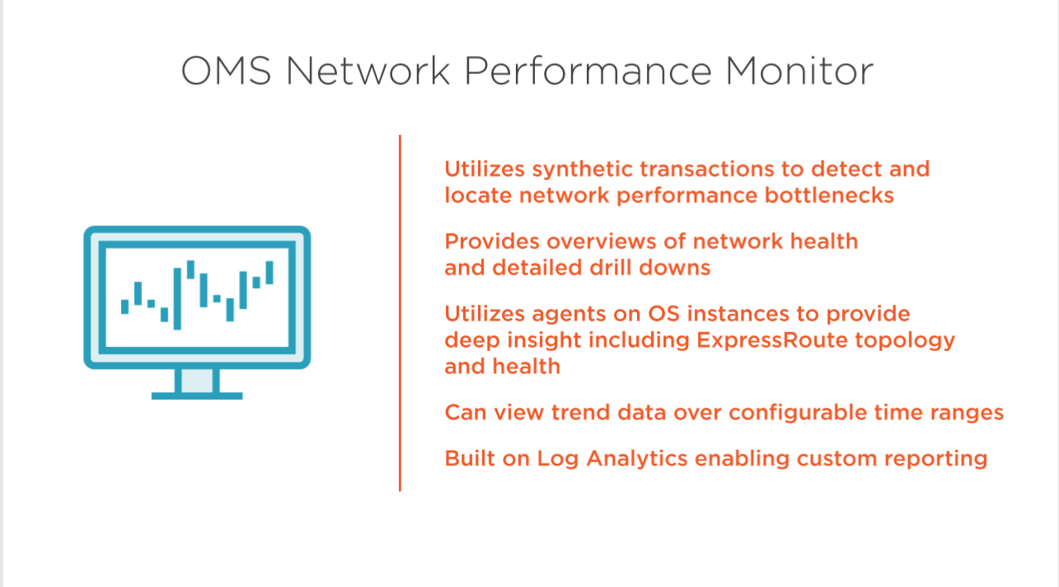

Slide 37
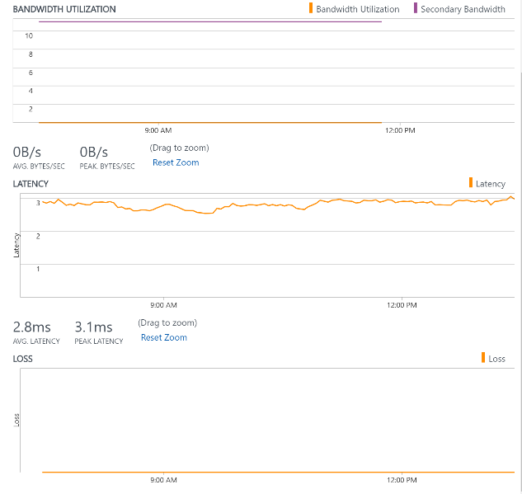
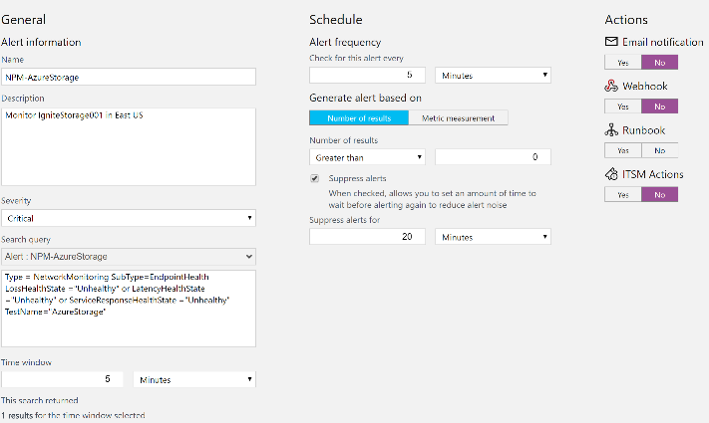
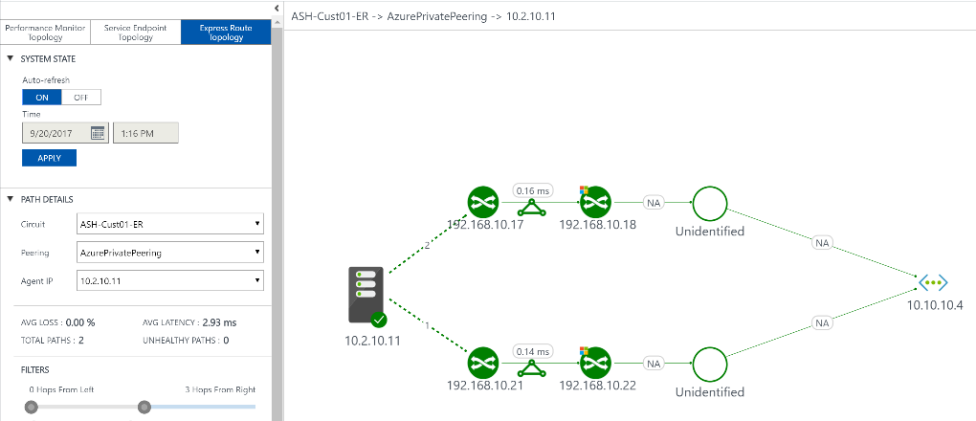
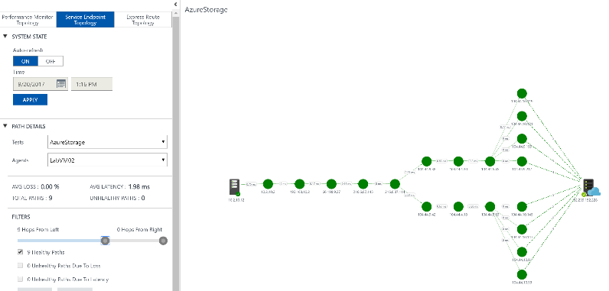
Network Performance Monitor for ExpressRoute
New
Continuously monitor
On-premises to Azure services
PaaS and SaaS services
Connection metrics, latency, packet loss
Analyze and Alert
OMS log analytics
Alert and act on key events
Localize networking issues
Notes:
Notes:
Remove the IP addresses

Slide 38
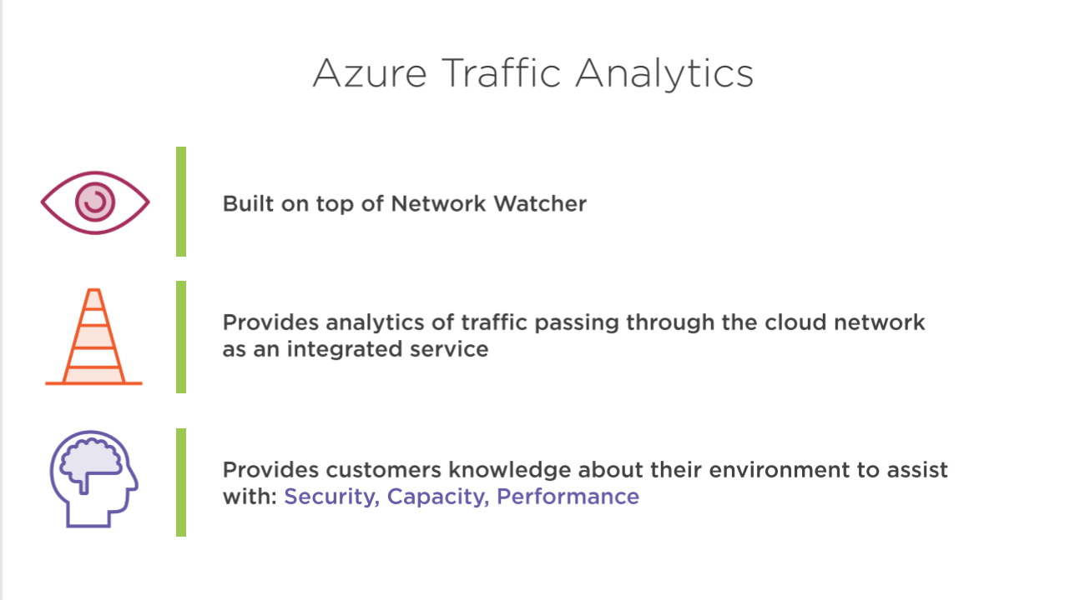

Slide 39
Azure Application Insights

Slide 40
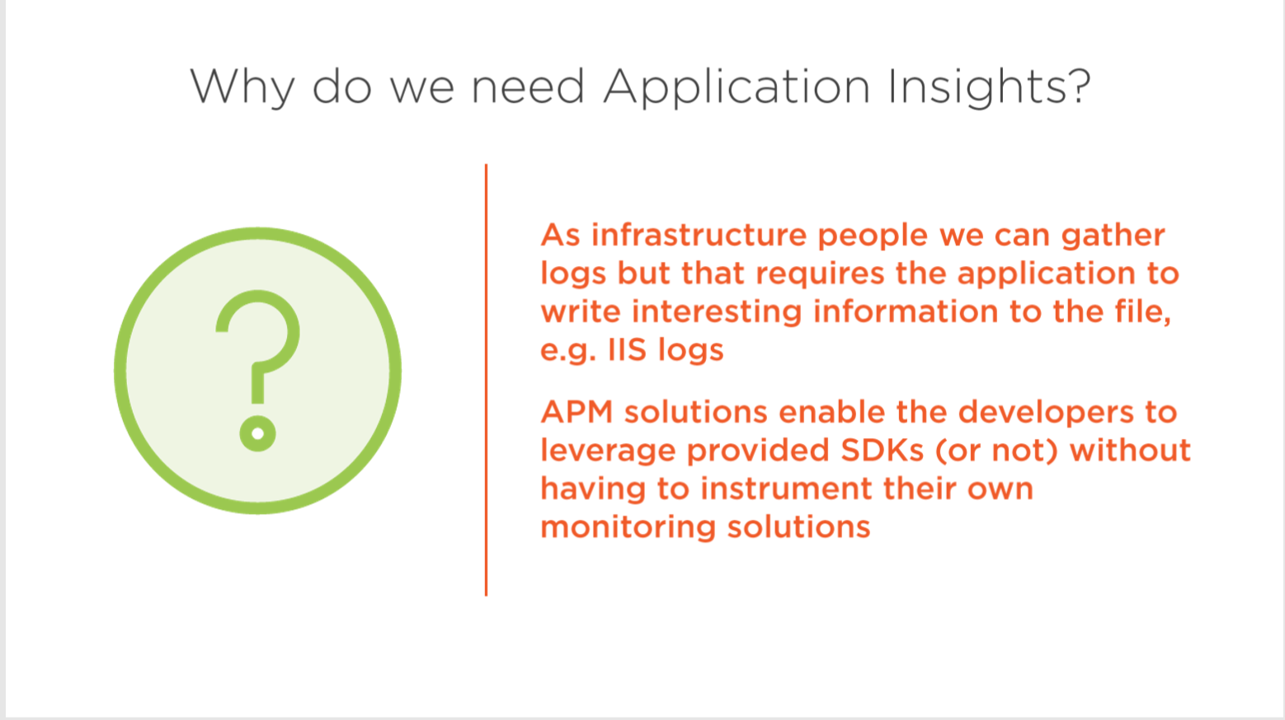

Slide 41
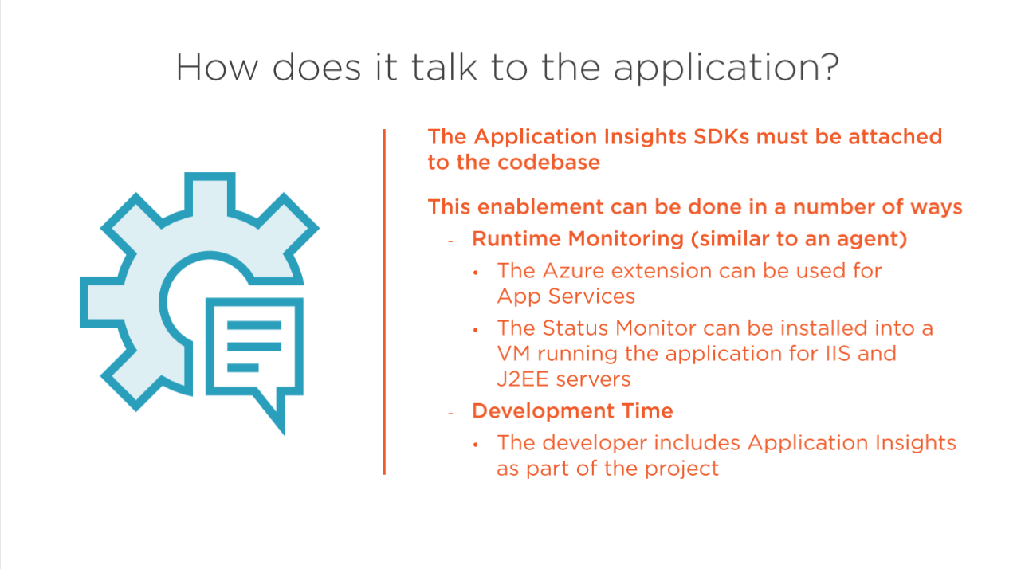

Slide 42
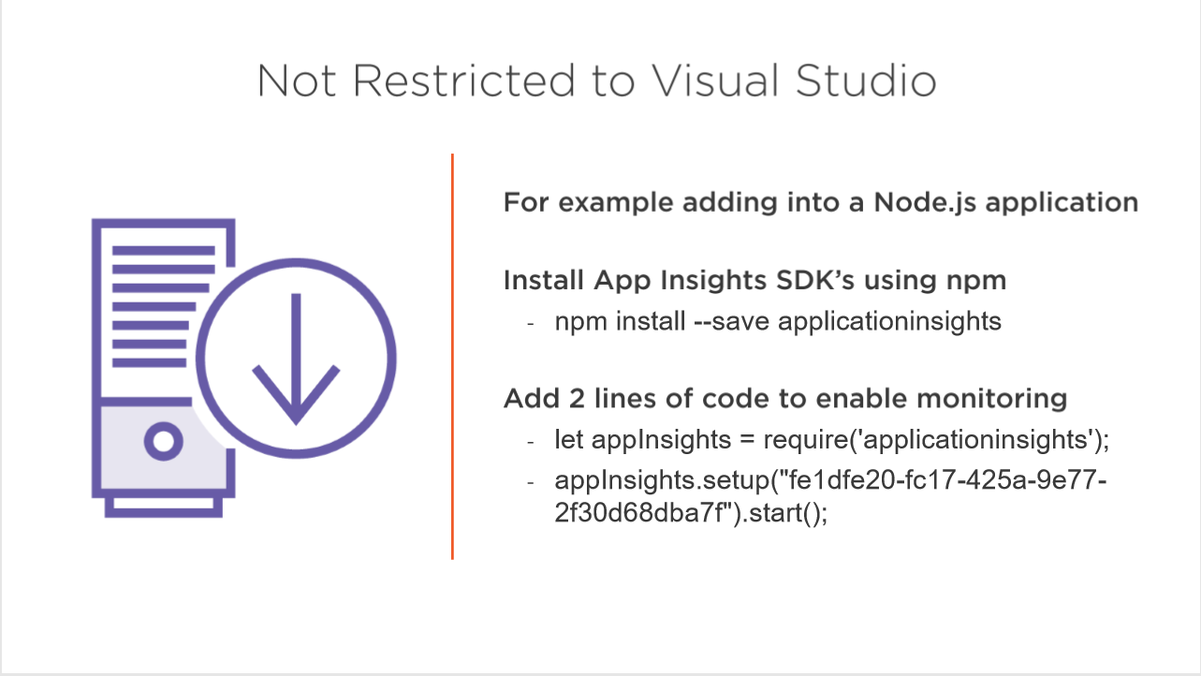

Slide 43
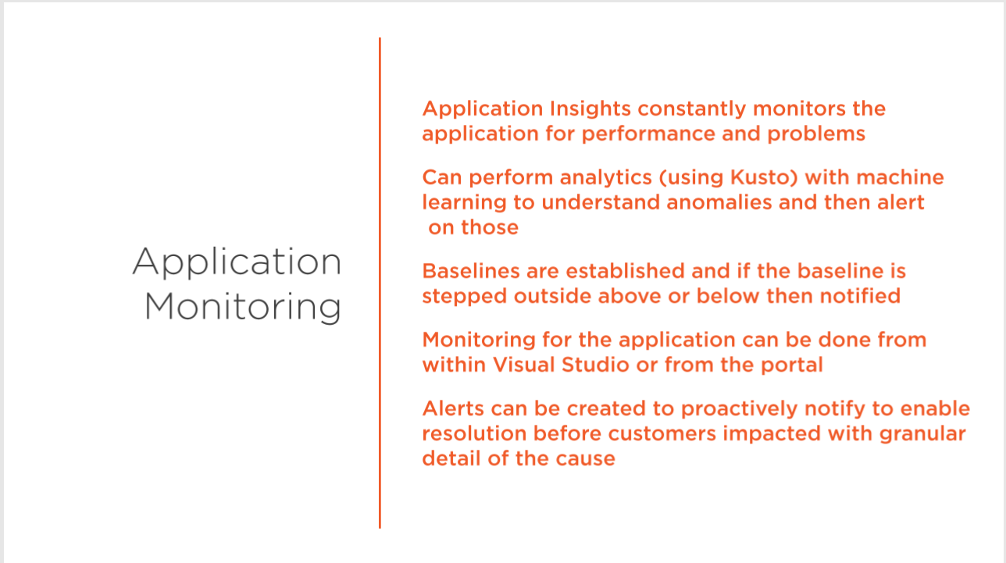

Slide 44
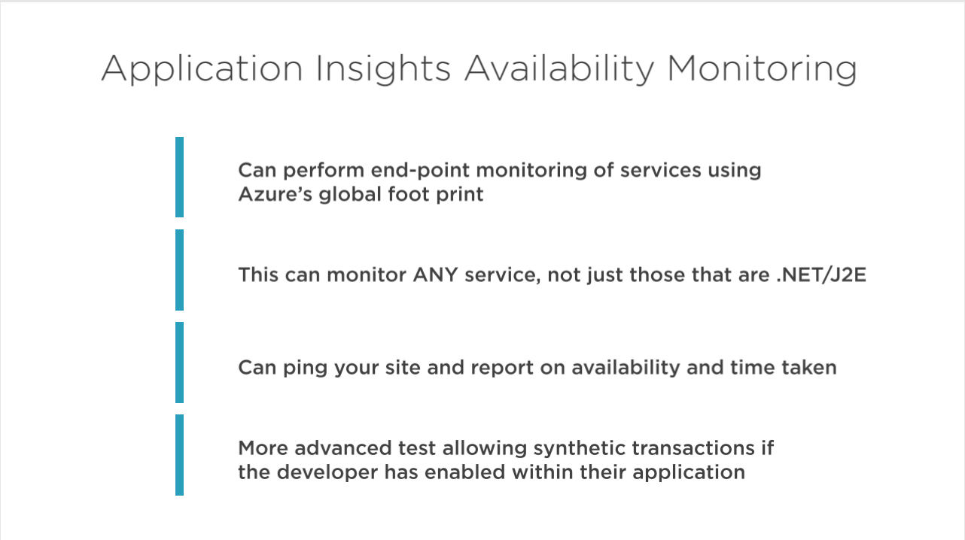

Slide 45
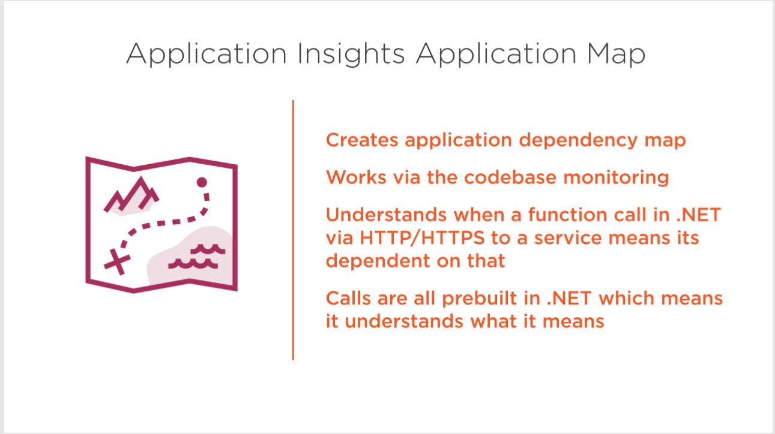

Slide 46
Azure Backup

Slide 47






















Azure Backup enables and solves…
Azure
Customer Challenges
100 Encrypted VMs
100 SQL in IaaS VMs
200 Linux App VMs
Cost
Security
Compliance
10 Azure File Shares
On-Premises
RODC
File Server
Send Quickly
Recover Quickly
Remote Offices
1 vCenter with 500+ VMs
RODC
File Server
Management at Scale

Slide 48
Azure Backup
Tier 2 Recovery Point
Azure IaaS VM
Tier 1 Recovery Point
Azure Backup Vault
R3 | 1 | 2 | 3 | 4
Storage Account
Recovery Points
Backup
Extension
R2 | 1 | 2 | 3 | 4
R1 | 1 | 2 | 3 | 4
Instant Recovery Point creation
Storage Account
Checksum Comparison
Snapshot
…
1
3
3
1
2
3
4
Disks
Data Blocks
Lightning Fast Backups
Ideal for Patch Scenarios
Full Restore Fidelity
Notes:
Speaker: Alejandra
How does Azure IaaS VM Backup work?
Starting on the left side, the Azure Backup service initiates the backup job at the scheduled time, and triggers the backup extension to take a snapshot. The backup extension coordinates with the in-guest VSS service to achieve consistency, and invokes the blob snapshot API of the Azure Storage service once consistency has been reached. This is done to get a consistent snapshot of the disks of the virtual machine, without having to shut it down.
After the snapshot has been taken, the data is transferred by the Azure Backup service to the backup vault. The service takes care of identifying and transferring only the blocks that have changed from the last backup – making the backup storage efficient. When the data transfer is completed, the snapshot is removed and a recovery point is created. This recovery point can be seen in the Azure management portal.
On the right, when you take the snapshot for of first copy, and you send it to the data blocks. With the second copy on the recovery points, you only send to the data blocks what has changed. In this case, you can see we take one full backup and have optimized our service for incremental changes moving forward.
VM Agent for Backup Documentation:
https://docs.microsoft.com/en-us/azure/backup/backup-azure-vms-first-look-arm#install-the-vm-agent-on-the-virtual-machine

Slide 49



Create a Recovery Services Vault
Notes:
create a Recovery Services Vault
Sign in to the Management Portal
Click New > Data Services > Recovery Services > Recovery Services Vault and choose Quick Create.
For the Name parameter, enter a friendly name to identify the Recovery Services Vault. Type a name that contains between 2 and 50 characters. It must start with a letter, and can contain only letters, numbers and hyphens. This needs to be unique for each subscription.
For the Region parameter, select the geographic region for the Recovery Services Vault. The choice determines the geographic region where your backup data is sent. By choosing a geographic region close to your location, you can reduce network latency when backing up to Azure.

Slide 50

Vault Credentials

Slide 51


Define a backup policy
Tip:
A backup policy includes a retention scheme for the scheduled backups. If you select an existing backup policy, you cannot modify the retention options in the next step.
Virtual machine backups can be retained for up to 99 years.
Notes:
Retention policy specifies the length of time for storing a backup. You can specify different retention policies based on when the backup is taken. For example, a backup point taken daily (which serves as an operational recovery point) might be preserved for 90 days. In comparison, a backup point taken at the end of each quarter (for audit purposes) may need to be preserved for many months or years.

Slide 52
Azure Site Recovery

Slide 53





Azure Site Recovery
Private cloud to Azure
Any Cloud
Public cloud to Azure
Azure
Azure to Azure
VMware
Hyper-V
Physical
AWS
AWS to Azure
Windows
Any OS
Linux
Notes:
Speaker: Alejandra
In the case of leveraging ASR; today we have several options:
VMware to Azure
Hyper-V to Azure
Physical/Bare metal to Azure
AWS to Azure
Azure to Azure

Slide 54




Azure Site Recovery
Create a Recovery Services Vault
Azure Site Recovery
Install and Register On-premises Software
Add VMM, Hyper-V, Physical, or vCenter Servers
DR Orchestration
Create and Associate a Replication Policy
Primary Site
Firewall
Replicate Virtual Machines
HTTPS Port 443 (outgoing)
Replication
VM1
VM3
VM1
VM3
Configure VM properties or Network
SCVMM
MASR Agent
VM2
VM4
VM2
VM4
Create Recovery Plan
HTTPS Port 443 (outgoing)
Firewall
VM1
VM1
VM3
VM3
Perform Failover
VM2
VM2
VM4
VM4
MARS Agent
MARS Agent
Optionally configure re-protection and Failback
Hyper-v Hosts
Notes:
Speaker: Alejandra
https://docs.microsoft.com/en-us/azure/site-recovery/vmware-walkthrough-overview#step-6-replicate-applications
Deploy the Recovery Services Vault in Azure
Upon opening this slide, Azure Site Recovery should show up in the top right
*click*
On-premises, install and register the Recovery Services software
The primary site, firewalls, Hyper-V hosts, and SCVMM should show up.
*click*
Create and associate a replication policy in Azure (show up the replication arrow, but leave it hollow)
*click*
Show both of these steps
Replicate Virtual Machines – The replication arrow should show up and fill it in with a solid color to show that it is active
Configure VM properties/Network
On the Azure Side, if it is possible to create a “cloned” VM icon that is faded to represent the on-premises one is waiting to be failed over to Azure
*click*
Create a Recovery Plan
Create a paper icon on the azure side to show that we have a plan on how VMs start up
*click*
Show both of these steps
Perform a Failover
Put an X on Replication, fade the icons for the primary site, and make the faded VMs in Azure now be visible
Optionally configure re-protection and failback
The animation timings for this slide should be right, it’s just getting the icons to show up

Slide 55




Azure to Azure : Architecture
VNET-ASR
VNET
Failover
Enable Replication
Availability Set
Availability Set
Replication
Manage Disk
S1Cache
Manage disk- ASR
Initial Replication

Slide 56


Application-aware Recovery
Enable Protection
Public IP
Public IP
VNET-ASR
VNET
LB
Failover
LB
Availability Set
Availability Set
SP
SP
ILB
ILB
S1
S1Cache
S1ASR
Availability Set
Availability Set
AD
AD
ILB
ILB
S2
S2Cache
S2ASR
Availability Set
Availability Set
SQL
SQL

Slide 57
SharePoint –HA Farm
Public IP
VNET
LB
Multi-tiered with Availability Set
Load balancers
Public IP connectivity
SQL Always ON
Availability Set
WEB1
WEB2
AD1
LB
ILB
AD2
S1
Availability Set
APP1
APP2
ILB
S2
Availability Set
SQLW
SQL1
SQL2

Slide 58
Application-aware Recovery
Public IP
VNET
Enable Protection
LB
Public IP
VNET
LB
Failover
Availability Set
Availability Set
WEB1
WEB2
WEB1
WEB2
AD1
S1Cache
S1ASR
LB
ILB
AD Replication
AD-DR
ILB
AD2
S1
Availability Set
Availability Set
APP2
APP1
APP1
APP2
Availability Set
Availability Set
ILB
ILB
S2
S2ASR
Availability Set
Availability Set
SQL Replication
SQLW
SQL1
SQL2
SQL-DR

Slide 59
Azure Automation

Slide 60
Azure Automaton
Automation Account
Assets
Runbooks
Author Runbooks
Desired State Configuration
Monitoring & Troubleshooting

Slide 61

Automation Assets
Azure Automation Assets are settings that are saved and made globally available to be used in or associated with a Runbook.
Assets are encrypted and stored in Azure Automation using a unique key that is generated for each Automation account.
The unique key is encrypted by a master certificate and stored in Azure Automation.
There are six different types of Automation Assets:
Certificates
Connections
Credentials
Integration Modules
Schedules
Variables
Notes:
Automation Assets. Azure Automation Assets are settings that are saved and made globally available to be used in or associated with a Runbook. These settings are often settings that are frequently used. Using Automation Assets means that you don’t have to retype these frequently used settings for each Runbook. The settings are written once and saved and then called by Runbooks when required. Assets are encrypted and stored in Azure Automation using a unique key that is generated for each Automation account. The unique key is encrypted by a master certificate and stored in Azure Automation. There are six different types of Automation Assets: Certificates, Connections, Credentials, Integration Modules, Schedules and Variables.

Slide 62

Credentials
An Automation credential asset holds a PSCredential object which contains security credentials such as a username and password.
Simplifies Runbook and DSC configurations that may use cmdlets that accept a PSCredential object for authentication.
Credentials can be created using PowerShell or the Azure portal.
Notes:
Credentials. An Automation credential asset holds a PSCredential object which contains security credentials such as a username and password. Credential objects can be used to simplify Runbook and DSC configurations that may use cmdlets that accept a PSCredential object for authentication. This allows you to specify an object that contains security credentials in a secure string as opposed to typing them in clear text in your Runbook or DSC configuration. Credentials can be created using PowerShell or the Azure portal.

Slide 63

Schedules
Azure Automation Schedules are used to schedule Runbooks to run automatically.
Could be either a single date and time or it could be a recurring hourly, daily, weekly, or monthly schedule to start the Runbook multiple times.
Schedules can be created using PowerShell or the Azure portal.
Schedules do not currently support Azure Automation DSC configurations.
Notes:
Schedules. Azure Automation Schedules are used to schedule Runbooks to run automatically. This could be either a single date and time or it could be a recurring hourly, daily, weekly, or monthly schedule to start the Runbook multiple times. Schedules can be created using PowerShell or the Azure portal and at present do not support Azure Automation DSC configurations.

Slide 64

Variables
Variable assets are values that are available to all Runbooks and DSC configurations in your automation account.
Can be created, modified, and retrieved from the Azure portal, PowerShell, and from within a Runbook or DSC configuration.
Automation variables are useful for:
Sharing a value between multiple Runbooks or DSC configurations.
Sharing a value between multiple jobs from the same Runbook or DSC configuration.
Managing a value from the portal or from a PowerShell command line that is used by Runbooks or DSC configurations.
Variables can be stored encrypted.
Notes:
Variables. Variable assets are values that are available to all Runbooks and DSC configurations in your automation account. They can be created, modified, and retrieved from the Azure portal, PowerShell, and from within a Runbook or DSC configuration.
Automation variables are useful for:
Sharing a value between multiple Runbooks or DSC configurations.
Sharing a value between multiple jobs from the same Runbook or DSC configuration.
Managing a value from the portal or from a PowerShell command line that is used by Runbooks or DSC configurations.
Variable assets can be stored encrypted and must be specified during creation if required.

Slide 65

What is a Runbook
In Azure Automation, a Runbook is a file that contains a set of procedures and operations.
Runbooks are used as input for the Azure Automation service to process.
The contents of a Runbook file is written using PowerShell or PowerShell Workflow commands.
PowerShell Workflow is a PowerShell extension that allows you to run a PowerShell script on multiple devices in parallel with added functionality such as checkpoints, suspend & restart.
Notes:
What is a Runbook. In Azure Automation, a Runbook is a file that contains a set of procedures and operations. Runbooks are used as input for the Azure Automation service to process. They contain the tasks that are to be automated by the Azure Automation service. You can think of a Runbook as the batch file or script to your Windows task scheduler job. The contents of a Runbook file is written using PowerShell or PowerShell Workflow commands. PowerShell Workflow is a PowerShell extension that allows you to run a PowerShell script on multiple devices in parallel with added functionality such as checkpoints, suspend & restart in the event of failure. These functions are not available in PowerShell alone and are very useful to have.
[EDITOR] TWB_Trevor:
09 October 2013 It seems odd to use “finally” here, given that this is not a long process – or, at least, has not been described in great detail. Kindly consider removing it, or replacing it with something that clarifies context.

Slide 66

Start a Runbook
There are 7 different ways in which you can start a Runbook.
Azure Portal
PowerShell
Azure Automation API
Webhooks
Respond to Azure Alert
Schedule
From Another Runbook
The most common methods in use today are Schedule, PowerShell, the Azure Portal and Webhooks.
Notes:
Start a Runbook. There are 7 different ways in which you can start a Runbook. The options that you have available are:
Azure Portal
PowerShell
Azure Automation API
Webhooks
Respond to Azure Alert
Schedule
Or From Another Runbook
The most common methods in use today are schedule, PowerShell, the Azure Portal and Webhooks.
[EDITOR] TWB_Trevor:
09 October 2013 It seems odd to use “finally” here, given that this is not a long process – or, at least, has not been described in great detail. Kindly consider removing it, or replacing it with something that clarifies context.

Slide 67

Runbook Processing
An Actor starts a runbook
Azure Automation notes that the runbook should be started
Cloud resources – Runbook acts on local Azure resources or other external resources reachable via the network
4a. On-Premises – Hybrid runbook
group sends the runbook to an
on-premises machine to run
4b. Runbook acts on its local
networked resources
4c. Job results are returned from
on-premises
Notes:
A Runbook Lifecycle. The following diagram illustrates a step-by-step process in the life cycle of a runbook. It includes different ways a runbook is started in Azure Automation, the components required for a Hybrid Runbook Worker to execute Azure Automation runbooks and interactions between different components.
An Actor or caller starts a Runbook, Azure Automation then notes that the Runbook should be started and ensures that it happens within 30 minutes. Based on the Runbook call i.e. Azure or Hybrid Worker, Azure Automation will then either send the Runbook to Azure resources for processing or forward the call to an on-premises Hybrid Worker for processing. Once received, the Hybrid Worker then sends the Runbook to an on-premises resource to run. The job results are then returned from on-premises to Azure Automation.

Slide 68

Runbook Authentication
Runbooks are authenticated using a Run As account, this allows the Runbook to execute it’s tasks under this accounts security context.
A Run As account can be created during the creation of an Azure Automation account or an existing account can be added later using PowerShell.
The Run As account that is created during the creation of an Azure Automation account is granted the Contributor Role for the Azure subscription.
Existing accounts that are used must be granted the appropriate permissions in order for the Runbook to complete its tasks.
Notes:
Runbook Authentication. Runbooks are authenticated using a Run As account, this allows the Runbook to execute it’s tasks under this accounts security context. Run As accounts can be created during the creation of an Azure Automation account or an existing account can be added later on using PowerShell. The Run As account that is created during the creation of an Azure Automation account is granted the Contributor Role for the Azure subscription. This permission is inherited by all child objects in the subscription. Existing accounts that are used as Run As accounts must be granted the appropriate permissions in order for the Runbook to complete its tasks.
[EDITOR] TWB_Trevor:
09 October 2013 It seems odd to use “finally” here, given that this is not a long process – or, at least, has not been described in great detail. Kindly consider removing it, or replacing it with something that clarifies context.

Slide 69

Start a Runbook using a Schedule
Automatically start a Runbook on an hourly, daily, or weekly schedule.
Manipulate the schedule through the Azure portal, PowerShell cmdlets, or Azure API.
Provide parameter values to be used with the schedule.
Notes:
Start a Runbook using a Schedule. You can automatically start runbook on hourly, daily, or weekly schedule. You can also manipulate the schedule through the Azure portal, PowerShell cmdlets, or Azure API. Make sure to provide parameter values to be used with schedule.
[EDITOR] TWB_Trevor:
09 October 2013 It seems odd to use “finally” here, given that this is not a long process – or, at least, has not been described in great detail. Kindly consider removing it, or replacing it with something that clarifies context.

Slide 70
Start a Runbook using PowerShell
Runbooks can be called from a command line with Windows PowerShell cmdlets.
The call can be included in an automated solution with multiple steps.
The request is authenticated with a certificate or OAuth user principal / service principal.
Provide simple and complex parameter values to start the Runbook.
Track job state.
Client required to support PowerShell cmdlets.
Notes:
Start a Runbook using PowerShell. Runbooks can be called from a command line with Windows PowerShell cmdlets. The call can be included in an automated solution with multiple steps. The request is authenticated with certificate or OAuth user principal / service principal. You can provide simple and complex parameter values and track your job state. The calling client is required to support PowerShell cmdlets.
[EDITOR] TWB_Trevor:
09 October 2013 It seems odd to use “finally” here, given that this is not a long process – or, at least, has not been described in great detail. Kindly consider removing it, or replacing it with something that clarifies context.

Slide 71

Start a Runbook using the Azure Portal
Is the simplest method with an interactive user interface.
Forms based to provide simple parameter values.
Easily track job state.
Access authenticated with Azure logon.
Notes:
Start a Runbook using the Azure Portal. This method is one of the simplest method’s with an interactive user interface. It is forms based to provide simple parameter values. You can easily track a job’s state and your access is authenticated by the Azure logon process.
[EDITOR] TWB_Trevor:
09 October 2013 It seems odd to use “finally” here, given that this is not a long process – or, at least, has not been described in great detail. Kindly consider removing it, or replacing it with something that clarifies context.

Slide 72
Start a Runbook using Webhooks
A Webhook is a HTTP POST request that is sent to a specific URL, on receiving the POST request, some action is taken i.e. start a Runbook.
The URL is generated during the creation of a Webhook and includes a built in security token that is used to authenticate the request when it is received by the Azure Automation service.
The Webhook URL must be specified in the application that will be making the request.
You cannot specify a custom URL and the URL expiration date cannot be changed after the Webhook as been created.
No ability to track job state through a Webhook URL.
A Webhook URL
Notes:
Start a Runbook using Webhooks. A Webhook is a HTTP POST request that is sent to a specific URL, on receiving the POST request, some action is taken i.e. start a Runbook. The URL is generated during the creation of a Webhook and includes a built in security token that is used to authenticate the request when it is received by the Azure Automation service. The Webhook URL must then be specified in the application that will be making the request. It is important to note that you cannot specify a custom URL and, that the URL expiration date cannot be changed after the Webhook as been created. There is also no ability to track job state through a Webhook URL.
[EDITOR] TWB_Trevor:
09 October 2013 It seems odd to use “finally” here, given that this is not a long process – or, at least, has not been described in great detail. Kindly consider removing it, or replacing it with something that clarifies context.

Slide 73

Hybrid Runbook Workers
Hybrid Runbook Workers allow you to run Runbooks on machines located in your local data center in order to manage local resources.
Runbooks are stored and managed in Azure Automation and downloaded by one or more designated on-premises machines via an agent.
Outbound TCP 443 is required since the agent on the local computer initiates all communication with Azure Automation.
Whitelist URL: *.azure-automation.net
Use the RunOn option in the Azure portal to select the
name of the Hybrid Runbook Worker to start a
Runbook.
Notes:
Hybrid Runbook Workers. The Hybrid Runbook Worker feature of Azure Automation allows you to run Runbooks on machines located in your local data center in order to manage local resources since the Azure Automation service is not VNet aware. Runbooks are stored and managed in Azure Automation and then delivered to one or more on-premises machines via an agent. Outbound TCP 443 is required since the agent on the local computer initiates all communication with Azure Automation. The URL *.azure-automation.net will also need to be added to your list of allowed websites. Runbooks that have been downloaded to a local machine can be started using the RunOn option in the Azure portal. This will allow you to select the name of the Hybrid Runbook Worker that will be used to start the Runbook.
[EDITOR] TWB_Trevor:
09 October 2013 It seems odd to use “finally” here, given that this is not a long process – or, at least, has not been described in great detail. Kindly consider removing it, or replacing it with something that clarifies context.

Slide 74

Runbook Job Status
Runbook job status can be monitored using the Jobs tile in the Azure Portal or using Get-AzureRmAutomationJob in PowerShell.
Runbook jobs running for more than 3 hours will be temporarily unloaded and resumed from their last checkpoint, this is known as the Fair Share Limit.
PowerShell Runbooks will be started from the beginning since they don't support checkpoints.
Runbooks are terminated with a status of ‘Failed, waiting for resources’ if they are restarted 3 consecutive times.
Notes:
Runbook Job Status. Runbook job status can be monitored using the Jobs tile in the Azure Portal or using Get-AzureRmAutomationJob in PowerShell. Runbook jobs running for more than 3 hours will be temporarily unloaded and resumed from their last checkpoint, this is known as the Fair Share Limit and used in order to share resources among all Runbooks in the cloud. This limit is not applicable to Runbook jobs running on Hybrid Runbook Workers. PowerShell Runbooks will be started from the beginning since they don't support checkpoints. Lastly, Runbooks are terminated with a status of ‘Failed, waiting for resources’ if they are restarted 3 consecutive times. This is to protect from Runbooks running indefinitely without completing. So when you create a Runbook, you should ensure that the time to run any activities between two checkpoints will not exceed 3 hours.
[EDITOR] TWB_Trevor:
09 October 2013 It seems odd to use “finally” here, given that this is not a long process – or, at least, has not been described in great detail. Kindly consider removing it, or replacing it with something that clarifies context.

Slide 75
Azure Event Grid

Slide 76
Azure Event Grid
Fully-managed event routing
Near real-time event delivery at scale
Broad coverage within Azure and beyond
Backbone of event-driven computing

Slide 77








Manage all events in one place
Event publishers
Event handlers
Blob Storage
Azure Functions
Resource Groups
Subscribe to pre-defined system events in Azure or create your own custom topics
Logic Apps
Azure Subscriptions
Route events to any end-points, Azure or even beyond
Azure Automation
Event Hubs
WebHooks
Custom Events
Enable filtering and efficient routing of events
Notes:
Near Real Time
Sub-second end-to-end latency in the 99th percentile
Massive Scale Out
10,000,000 events per second per region
Highly Reliability
24-hour retry with exponential back off for events not delivered

Slide 78



Scenarios
Serverless apps
Ops automation
Application integration
Instantly trigger a serverless function to run analysis when a new file is added to a blob storage container.
Speed up automation and simplify policy enforcement by notifying Azure Automation when underlying infrastructure is provisioned
Connects your app with other services. Create an application topic to route your app’s event data to any desired destination

Slide 79
Azure Infra Provisioning and Configuration Management

Slide 80
Azure Infra Provisioning and Configuration Management
Infrastructure Provisioning
Azure PowerShell
Azure CLI
Azure ARM Templates
Teraform
Configuration Management
PowerShell DSC (Desired State Configuration)
Chef
Puppet
Ansible

Slide 81
Azure Cost Management

Slide 82


